Slide 1
Sysgem Enterprise Manager (SEM)
Notes:
Multi-Platform System Management: “Sysgem Enterprise Manager” (SEM).

Slide 2
Overview
SEM is a multi-platform product
It supports: Unix, Linux, OpenVMS, Windows
SEM has several modules:
Sysgem Account Management SAcM
Sysgem System Management SSyM
Self-Service Password Reset SSPR
Sysgem Distributed File Synchronizer SFiS

Slide 3
Objectives
Out-of-the box
Easy customization
Ease of use
Secure
Minimal maintenance effort
Low total cost

Slide 4
Ease of Use
Account and System Management:
Help-desk operators and non-technical people substitute expensive system administrators for routine tasks

Slide 5
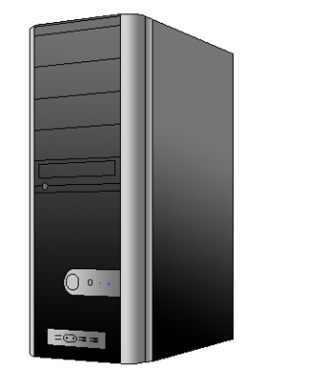
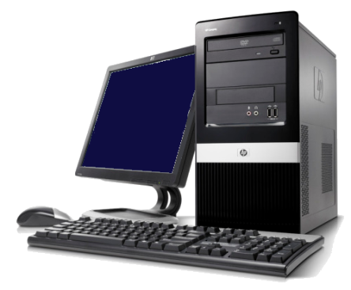
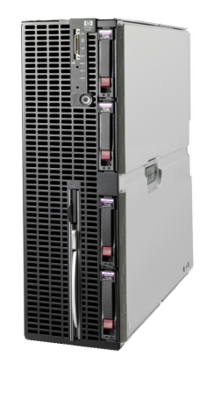
Sysgem Enterprise Manager
SEM Client
SEM Authorization Server
SEM User
SEM Agents
Notes:
1. All messages sent from the SEM Client to target servers will first be ‘signed’ by the SEM Authorization Server and returned to the GUI for onward transition to the target server(s).

Slide 6
Live Demonstration

