Slide 1
Securely Managing VMS from a Windows Environment
Notes:
This presentation describes what we set out to achieve in Sysgem Enterprise Manager and outlines the security considerations for the project.

Slide 2
Objectives
Delegation:
Management tasks to be undertaken by help desk operators
User interface on Windows
Notes:
1. Have you ever known a system manager with time to spare?
2. The primary objective of Sysgem Enterprise Manager (SEM) is to provide a secure system whereby routine tasks can be offloaded from busy, technical (and therefore expensive), system managers and assign those tasks to other (less-technically experienced) individuals in the organization such as help desk operators.
3. Since the primary user of SEM will be help desk operators, user administrators, security managers, etc. we want the UI to be intuitive, non-technical and be available on users’ desktops. We chose a GUI interface on the Windows platform. [One may ask – why not a browser interface? And indeed that would have perhaps have been a better interface for general use, but actually would have been very much more difficult to make it customizable – which was another of our objectives.]

Slide 3
Objectives
Delegation:
Management tasks to be undertaken by help desk operators
User interface on Windows
Authorization:
Authorization Server to hold permission profiles for logged-in users
Notes:
1. Authorization Server to be the focal point of Sysgem Enterprise Manager (SEM).
2. SEM users to have an account that is held at the Authorization Centre.
3. SEM user accounts to hold profiles (for permissions) that determine the level of access for individual users.

Slide 4
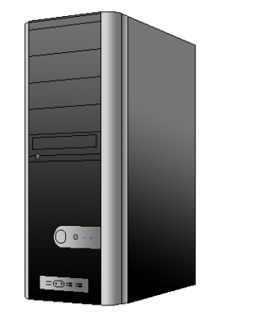
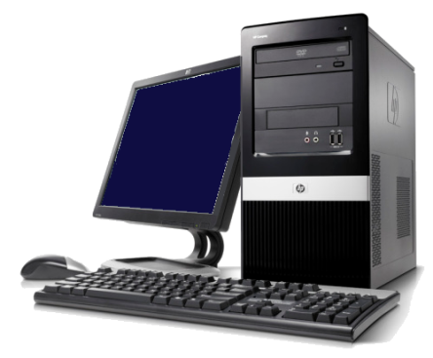
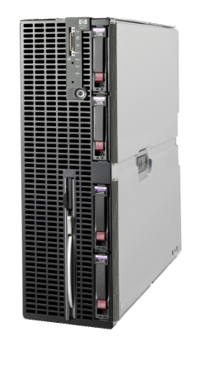
Authorization
(Software Components)
SEM Client
SEM Authorization Server
Authorization Server
SEM User
Target Servers
SEM Agents
Notes:
SEM software components to be split between three locations:
The user’s Windows workstation
A central Windows Server that we shall name the “Authorization Server”
The target systems to be managed
2. In these locations we will have the following software components:
Workstation: “SEM Client” – to provide all the GUI to the user
Central Authorization Server: “SEM Authorization Server” – to be the secure location for validation SEM user logins, repository for user permissions, all script and UI libraries, Audit and other databases, SEM certificate authority.
Target System: “SEM Agent” – to be used as a ‘script processing engine’ – communicates with the SEM Client, receives and executes scripts sent by the client and returns output to it.

Slide 5
Objectives
Delegation:
Management tasks to be undertaken by help desk operators
User interface on Windows
Authorization:
Authorization Server to hold permission profiles for logged-in users
Software Management:
SEM Authorization Server to hold all scripts for target servers
Notes:
Authorization Server holds all scripts that are run on target managed servers
2. Updates and customizations concentrated here
3. Scripts transmitted to SEM agents with every transaction
4. So, s/w is self propagated to all managed servers from the central Authorization Server

Slide 6
Objectives
Delegation:
Management tasks to be undertaken by help desk operators
User interface on Windows
Authorization:
Authorization Server to hold permission profiles for logged-in users
Software Management:
SEM Authorization Server to hold all scripts for target servers
Message Signing:
Authorization Server ‘signs’ all transaction messages
Notes:
1. For security reasons, all transaction messages used in the SEM network are first ‘signed’ by the Authorization Server.
2. Unsigned or incorrectly signed messages will be rejected by recipient software components.

Slide 7
Message Signing
SEM Client
SEM Authorization Server
SEM User
SEM Agents
Notes:
1. All messages sent from the SEM Client to target servers will first be ‘signed’ by the SEM Authorization Server and returned to the GUI for onward transition to the target server(s).

Slide 8
Objectives
Delegation:
Management tasks to be undertaken by help desk operators
User interface on Windows
Authorization:
Authorization Server to hold permission profiles for logged-in users
Software Management:
SEM Authorization Server to hold all scripts for target servers
Message Signing:
Authorization Server ‘signs’ all transaction messages
SEM Databases:
Authorization Server writes databases such as the SEM Audit Trail
Notes:
SEM databases such as the SEM Audit Trail Database can be located in any location as they are accessed via ‘Open Database Connectivity’ (ODBC) but by default they will be centralised at the Authorization Server
The SEM Authorization Server makes calls to ODBC routines to write to the databases.

Slide 9
Objectives (continued)
Secure Network:
Use of SSL/TLS
Alternative security mechanisms
Notes:
1. An installation option allows SSL/TLS to be used for network security or if a customer prefers, e.g. for legacy systems where SSL is not available or is not convenient to be used, an alternative communication security mechanism is made available by SEM.

Slide 10
Secure Network (SSL/TLS)
SEM Client
SSL/TLS
SSL/TLS
SEM Authorization Server
SEM User
SEM Agents
Notes:
1. If SSL is being used then all communication connections between the SEM software components are transmitted via SSL.

Slide 11
Objectives (continued)
Secure Network:
Use of SSL/TLS
Alternative security mechanisms
Audit Trail:
Notes:
An Audit database is maintained at the SEM Authorization Server that gives all information available to us regarding all Help Desk (user account admin) transactions. For instance it records the following:
Date and time of the transaction
The identity of the SEM user account used to conduct the transaction
The identity of the target server and the target object (e.g. a user account ID)
The nature of the transaction (create/modify/delete/enable/disable/etc.)
The details of the input submitted (except for passwords)
If the transaction is an account modify transaction then the before and after states of the fields modified
The identity of the workstation used by the SEM user
The identity of the Windows user account (used by the SEM user) to log into Windows on the workstation

Slide 12
Objectives (continued)
Secure Network:
Use of SSL/TLS
Alternative security mechanisms
Audit trail:
Target platforms also to include:
Linux
UNIX
Windows
OS400 … in addition to VMS
Notes:
1. Not only are VMS severs managed / monitored, but so too are Linux, UNIX, Windows, OS400

Slide 13
Objectives (last but not least)
Easily customized
Notes:
1. An important objective for the project is to allow customers to view and if required to modify all scripts that run on target servers and all input forms - to give a completely customised view or set of actions.
2. In this respect, the entire system was to have an ‘open’ architecture and, importantly, procedures put into place so that any customer changes introduced into the system can be carried forward and preserved into the next version should the standard UI and scripts, from Sysgem, be modified between releases. This protects the customers’ investment in making those changes to the product.

