Slide 1
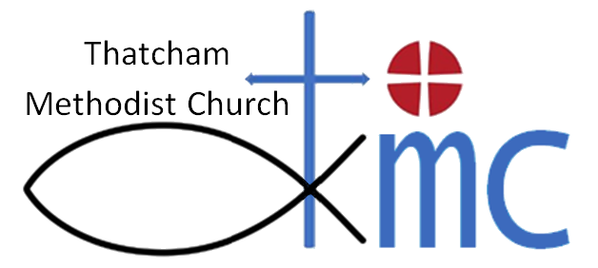
Agenda: 10-Oct-2018
Opening Devotions
Confirmation of Members of Meeting and Apologies for Absence
Minutes of meeting held on 6th June 2018
Matters Arising
Notification of Any Other Business
Stewards’ Report
Appointment of Cradle Roll Secretary
Property matters
Schedules
Recent and ongoing work
Financial matters
Accounts and budget
Fundraising for projects

Slide 2
Fundraising
10-Oct-2018

Slide 3
Project
New front, side & rear doors
Complete refurbishment of toilets at the rear of church
New floor covering – corridor to the back hall
Roof insulation – at the rear of church
Linked smoke / heat / CO alarms
Needs an ‘Eye-Watering’ £23,904

Slide 4
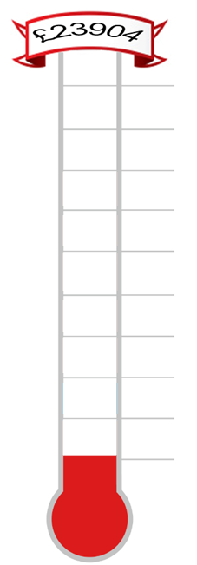
Refurbishment Fund
(with donations so far)
Future?
Englefield / Thatcham Town?
90%
10-October-2018
80%
£16,680
70%
£7,580 Circuit (31.87%)
60%
50%
£9,100
40%
£2,000 Berks Churches (8.4%)
£7,100
30%
£2,490 Matched + G.A. (10.5%)
£4,610
£2,570
20%
£2,040 Members (8.6%)
10%
£2,370 TGE Grant (10%)
0%
£200 Start Fund (0.8%)

Slide 5
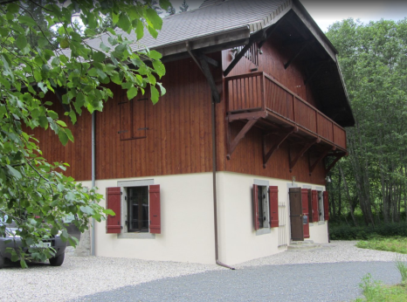
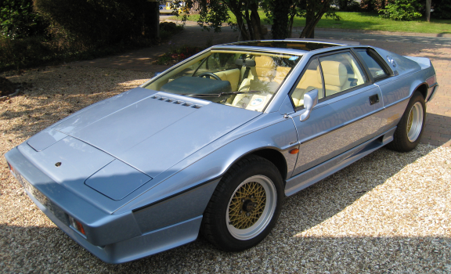
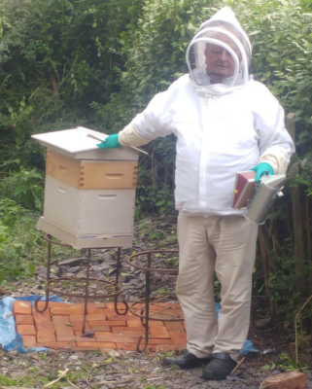
‘Auction of Promises’ to hit our target?
Holiday in the French Alps?
Ride in a Lotus Turbo Esprit?
Bee-keeping experience day?

Slide 6
Agenda (continued)
Worship including Saturday Shift, Café Church and Christmas Plans
Children and Young People
Pied Piper
The Well
Sunday School
Safeguarding
General Data Protection Regulations (GDPR)
Circuit Stewards’ Report
Churches Together in Thatcham
Any Other Business
Date of future meetings
Closing Prayer

Slide 7
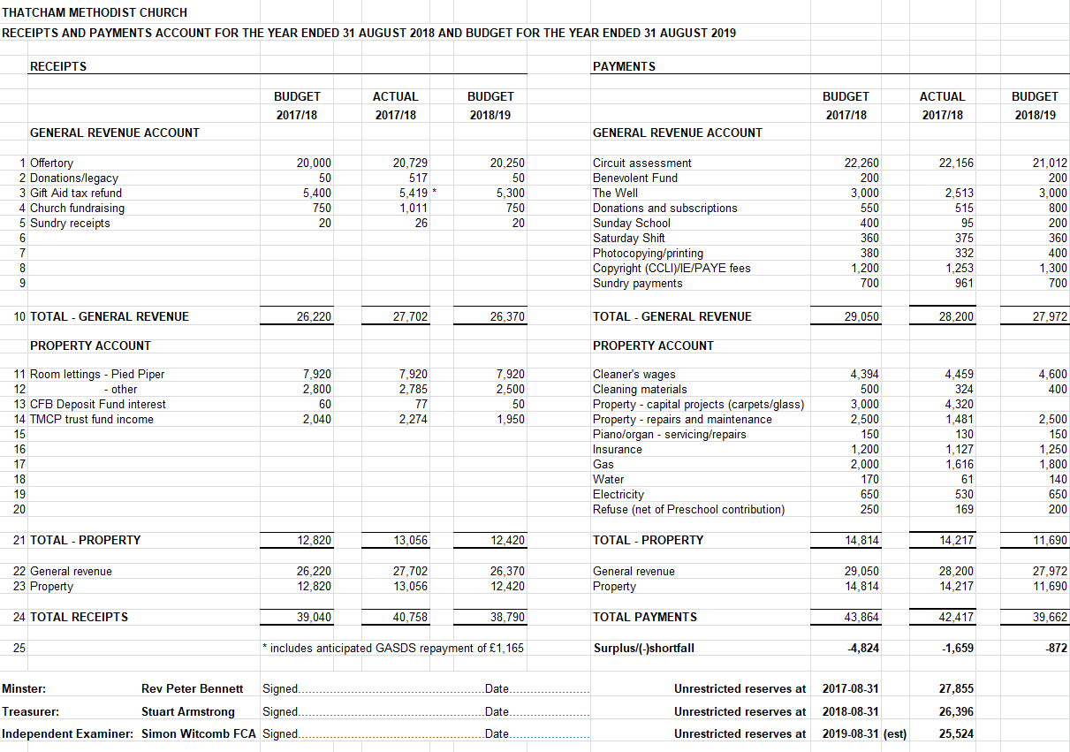

Slide 8
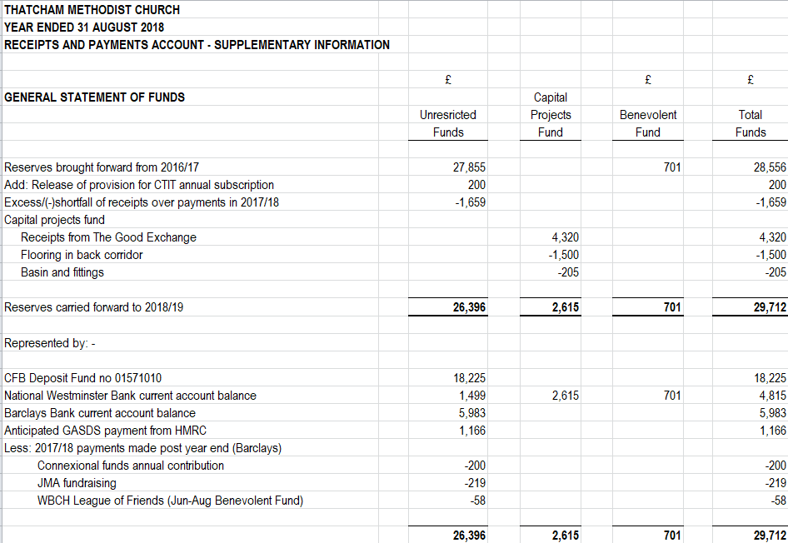

Slide 9
