Slide 1
Managing and Monitoring VMS from a Windows Workstation Shoshana Huss, Sysgem AG Mike Schofield, Sysgem AG
Notes:
Notes on this PowerPoint Presentation:
A. Slides 5, 8 and 17 should be viewed as a ‘slide show’ in order to see the animation.
B. Slides 18–23 were not shown during the presentation since this part of the presentation was an interactive demo of the SEM. Slides 17-22 are screenshots that give an indication of that demonstration.
C. Print slides in “Notes Pages” format to see ‘voice-over’ notes.
This presentation describes what we set out to achieve when designing and building ‘Sysgem Enterprise Manager’ (SEM) and outlines the security considerations for the project.
Instructors: Shoshana Huss, Mike Schofield
Session Level: Intermediate
Intended Audience: System Managers, Help Desk Managers, Security Managers and User Administrators
Session Abstract:
This session addresses the problems of centralized help desk operations and system management of multiple VMS servers from a Windows environment. It describes how system managers can connect to multiple VMS servers and run DCL scripts in parallel on those servers, viewing output in a single central window. Directories and files on multiple VMS servers may be viewed in a browser window and VMS files such as .lis, .log, .com, etc. are created / edited / deleted from the Windows environment.
Reports can be taken on: server availability; disk space; process and memory usage; queues; databases; files; etc. Alarms can be triggered when unexpected events occur or thresholds are exceeded.
User administration can be delegated to nominated help desk operators for: password management; account creation / modification / deletion. All transactions are recorded in an audit log for security purposes.
A development interface gives the ability to customize standard procedures and write purpose-written tasks under a common umbrella. No need to learn new script languages. All scripts that run in the VMS environment are written in DCL.
Key benefits are: system managers can save a lot of time by executing routine tasks in parallel. Help desk operations can be delegated in confidence and safety to less technically experienced staff. Early warnings of problems using 24/7 monitoring of systems and triggering of alarms help you keep on top of situations. And target servers may also be on Windows, Linux and UNIX platforms too!

Slide 2
Sysgem Enterprise Manager (SEM)
Notes:
Multi-Platform System Management: “Sysgem Enterprise Manager” (SEM).

Slide 3
Objectives
Delegation:
Management tasks to be undertaken by help desk operators
User interface on Windows
Notes:
1. Have you ever known a system manager with time to spare?
2. The primary objective of Sysgem Enterprise Manager (SEM) is to provide a secure system whereby routine tasks can be offloaded from busy, technical (and therefore expensive), system managers and assign those tasks to other (less-technically experienced) individuals in the organization such as help desk operators.
3. Since the primary user of SEM will be help desk operators, user administrators, security managers, etc. we want the UI to be intuitive, non-technical and be available on users’ desktops. We chose a GUI interface on the Windows platform. [One may ask – why not a browser interface? And indeed that would have perhaps have been a better interface for general use, but actually would have been very much more difficult to make it customizable – which was another of our objectives.]

Slide 4
Objectives
Delegation:
Management tasks to be undertaken by help desk operators
User interface on Windows
Authorization:
Authorization Server
the focal point for SEM security
used for the authorization of SEM users
used for the management of SEM software
used for the signing of messages
default location for the audit trail and other SEM databases
Notes:
1. Authorization Server to be the focal point of Sysgem Enterprise Manager (SEM).
2. SEM users to have an account that is held at the Authorization Centre.
3. SEM user accounts to hold profiles (for permissions) that determine the level of access for individual users.
4. Authorization Server ‘signs’ messages before transmission to Agents.
5. Authorization Server is default locations for Audit Trail and other SEM databases.

Slide 5
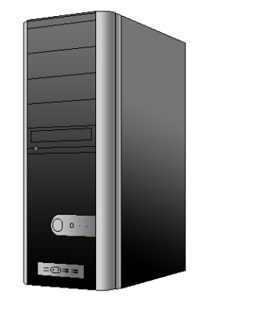
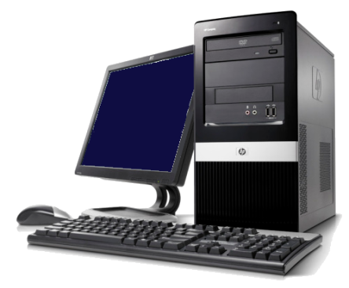
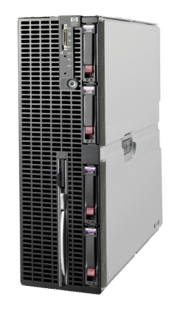
Authorization
(Software Components)
SEM Client
SEM Authorization Server
Authorization Server
SEM User
SEM Agents
Target Servers
Notes:
SEM users log into SEM using client software on their workstations to access their SEM user accounts held at the Authorization Server.
User profiles at Authorization Server control SEM account permissions.
SEM software components split between three locations:
The user’s Windows workstation
A central Windows Server that we shall name the “Authorization Server”
The target systems to be managed
In these locations we will have the following software components:
Workstation: “SEM Client” – to provide all the GUI to the user
Central Authorization Server: “SEM Authorization Server” – to be the secure location for validation SEM user logins, repository for user permissions, all script and UI libraries, Audit and other databases, SEM certificate authority
Target System: “SEM Agent” – to be used as a ‘script processing engine’ – communicates with the SEM Client, receives and executes scripts sent by the client and returns output to it

Slide 6
Objectives
Delegation:
Management tasks to be undertaken by help desk operators
User interface on Windows
Authorization:
Authorization Server to hold permission profiles for logged-in users
Software Management:
SEM Authorization Server to hold all scripts for target servers
Notes:
Authorization Server holds all scripts that are run on target managed servers.
2. Updates and customizations concentrated here.
3. Scripts transmitted to SEM agents with every transaction.
4. So, software is self propagated to all managed servers from the central Authorization Server.

Slide 7
Objectives
Delegation:
Management tasks to be undertaken by help desk operators
User interface on Windows
Authorization:
Authorization Server to hold permission profiles for logged-in users
Software Management:
SEM Authorization Server to hold all scripts for target servers
Message Signing:
Authorization Server ‘signs’ all transaction messages
Notes:
1. For security reasons, all transaction messages used in the SEM network are first ‘signed’ by the Authorization Server.
2. Unsigned or incorrectly signed messages will be rejected by recipient software components.

Slide 8
Message Signing
SEM Client
SEM Authorization Server
SEM User
SEM Agents
Notes:
1. All messages sent from the SEM Client to target servers will first be ‘signed’ by the SEM Authorization Server and returned to the GUI for onward transition to the target server(s).

Slide 9
Objectives
Delegation:
Management tasks to be undertaken by help desk operators
User interface on Windows
Authorization:
Authorization Server to hold permission profiles for logged-in users
Software Management:
SEM Authorization Server to hold all scripts for target servers
Message Signing:
Authorization Server ‘signs’ all transaction messages
SEM Databases:
Authorization Server writes databases such as the SEM Audit Trail
Notes:
SEM databases such as the SEM Audit Trail Database can be located in any location as they are accessed via ‘Open Database Connectivity’ (ODBC) but by default they will be centralised at the Authorization Server.
The SEM Authorization Server makes calls to ODBC routines to write to the databases.

Slide 10
Objectives (continued)
Secure Network Protocol:
Use of SSL/TLS
Alternative security mechanisms
Notes:
1. An installation option allows SSL/TLS to be used for network security or if a customer prefers, e.g. for legacy systems where SSL is not available or is not convenient to be used, an alternative communication security mechanism is made available by SEM.

Slide 11
Secure Network (SSL/TLS)
SEM Client
SSL/TLS
SSL/TLS
SEM Authorization Server
SEM User
SEM Agents
Notes:
1. If SSL is being used then all communication connections between the SEM software components are transmitted via SSL.

Slide 12
Objectives (continued)
Secure Network:
Use of SSL/TLS
Alternative security mechanisms
Audit Trail:
date and time
the SEM user who conducted the transaction
the target server and target object
the nature of the transaction
input details
before and after states of modified fields
the Windows user account (used by the SEM user)
the workstation used by the SEM user
Notes:
An Audit database is maintained at the SEM Authorization Server that gives all information available to us regarding all Help Desk (user account admin) transactions. For instance it records the following:
Date and time of the transaction
The identity of the SEM user account used to conduct the transaction
The identity of the target server and the target object (e.g. a user account ID)
The nature of the transaction (create/modify/delete/enable/disable/etc.)
The details of the input submitted (except for passwords)
If the transaction is an account modify transaction then the before and after states of the fields modified
The identity of the workstation used by the SEM user
The identity of the Windows user account (used by the SEM user) to log into Windows on the workstation

Slide 13
Objectives (continued)
Target platforms also to include:
Linux
UNIX
Windows
OS400 … in addition to VMS
Notes:
1. Not only are VMS servers managed / monitored, but so too are Linux, UNIX, Windows, OS400.

Slide 14
Objectives (continued)
Target platforms also to include:
Linux
UNIX
Windows
OS400 … in addition to VMS
Easily customized
Open Architecture
Notes:
1. Not only are VMS servers managed / monitored, but so too are Linux, UNIX, Windows, OS400.

Slide 15
Sysgem Enterprise Manager (SEM)

Slide 16
Sysgem System Manager Dashboard
SEM
New Product Announcement
Dashboard

Slide 17
Benefits - Customer Examples
Industry: US Steel Manufacturing
Goal: Avoid costly downtime – need to keep plant running 24/7
Examples of alarms configured by the customer using SEM:
High CPU usage (runaway processes)
Disk drive failure
RAID controller cache battery
Consequence: “Avoids catastrophic downtime of our plant which would cost us $20,000 per hour or more”

Slide 18
Benefits - Customer Examples
Industry: International Aerospace Manufacturing
Goal: To provide a Network Operations Center (NOC)
“Our organization didn’t have an NOC, so we’ve leveraged SEM as a ‘Virtual NOC’.”
A few examples where SEM is used:
Network
System Security
Operations
Hardware
Watchdog jobs add more processes whereas SEM has only one agent process on a server
No digging through log files – just glance at SEM for real-time status displays

Slide 19
Demonstration
Sysgem Enterprise Manager
OpenVMS Servers
Mike Schofield, Sysgem AG
Notes:
Pick up on some of the points Shoshana has made & show SEM in Action.
As Shoshana said: Agents are Script Processing Engines .

Slide 20
Sysgem Enterprise Manager
SEM Client
SEM Authorization Server
SEM User
SEM Agents
Notes:
All messages sent from the SEM Client to target servers will first be ‘signed’ by the SEM Authorization Server and returned to the GUI for onward transition to the target server(s).
All transactions transfer scripts for processing the input along with the input itself
Agent processes transaction and returns output in ‘results’ window on workstation

Slide 21
Sysgem Enterprise Manager (SEM)

Slide 22
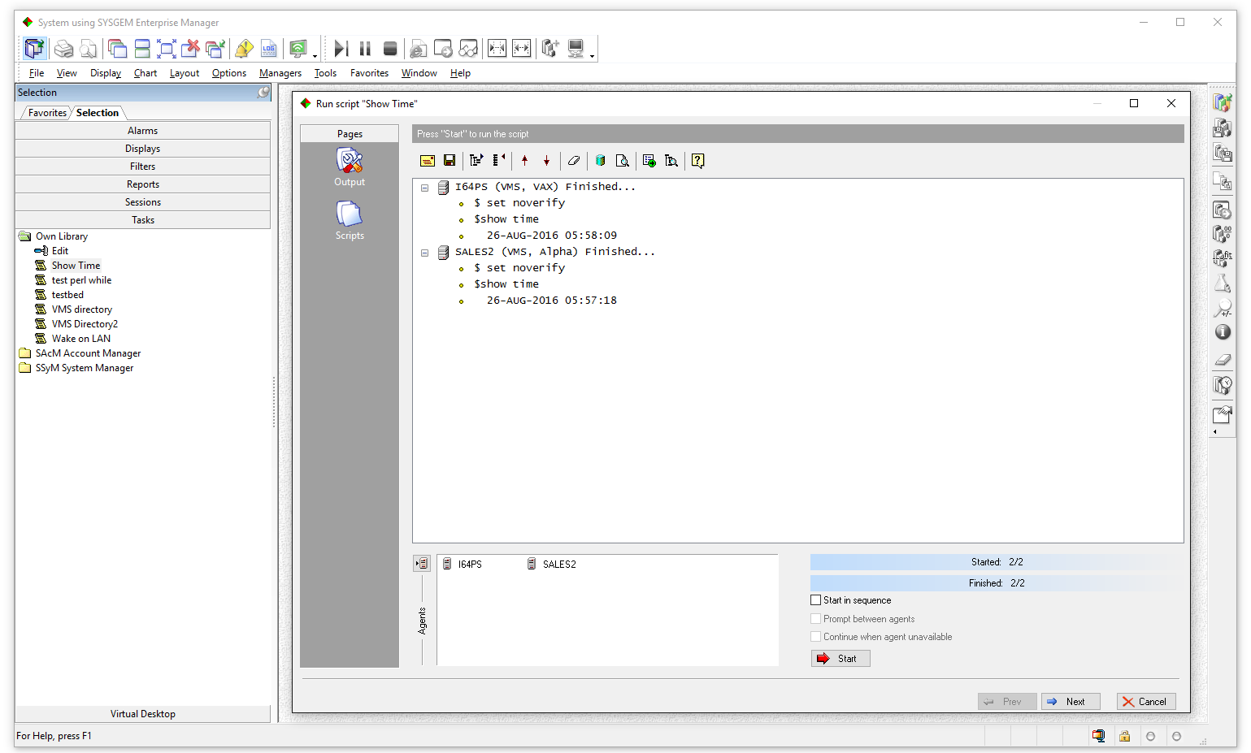
Demo1 – Task Scripts
Notes:
Start the demo with simplest management tool – Task Scripts.
Type DCL commands – execute them on multiple VMS Servers.
To demonstrate - use “$ Show Time” .
Since SEM automatically adds “set noverify” - add “Set Verify” for the demo.
Output from DCL Script shown in ‘Results’ pane.
Add a Parameter form and pass parameters at run time to the script.
Demo parameters with a VMS Directory command.
Export Results window.

Slide 23
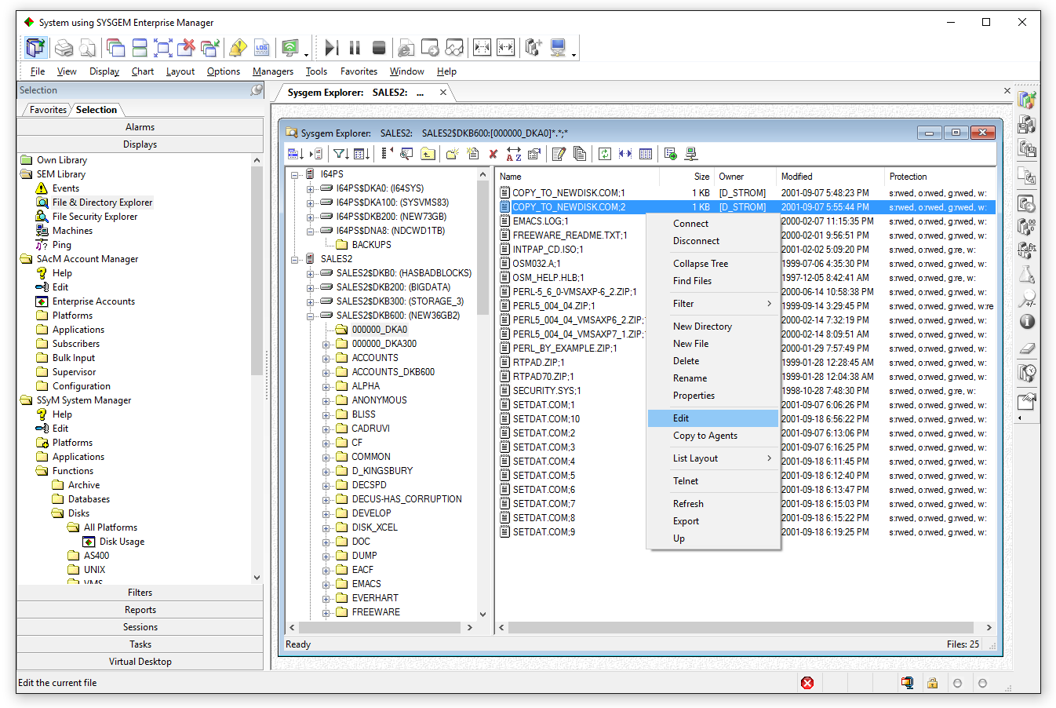
Demo2 – File & Dir Explorer
Notes:
Connect to multiple servers (and incidentally multiple platforms) with the “File and Directory Explorer” .
Rename, Delete, files and with the editor on your workstation edit / create text files on the remote servers.
Also copy files between servers (retaining file attributes).

Slide 24
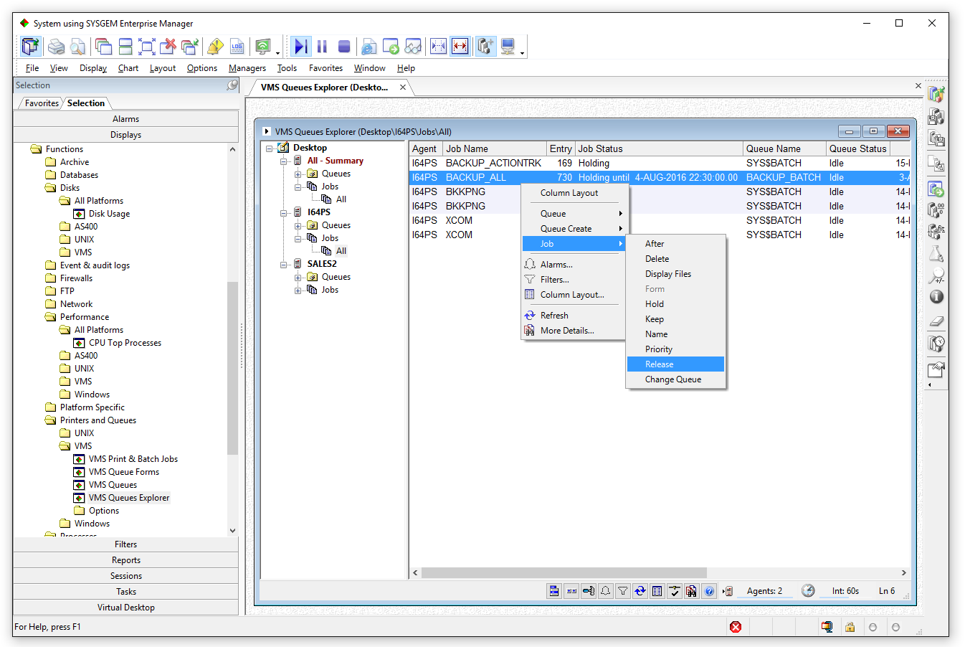
Demo3 – Queues
Notes:
Display Print / Batch Queues from multiple servers in explorer window.
Queues and jobs can all be managed from this window.
e.g.
queues can be stopped / started
jobs put on hold / released
Waiting jobs dragged and dropped to another queue

Slide 25
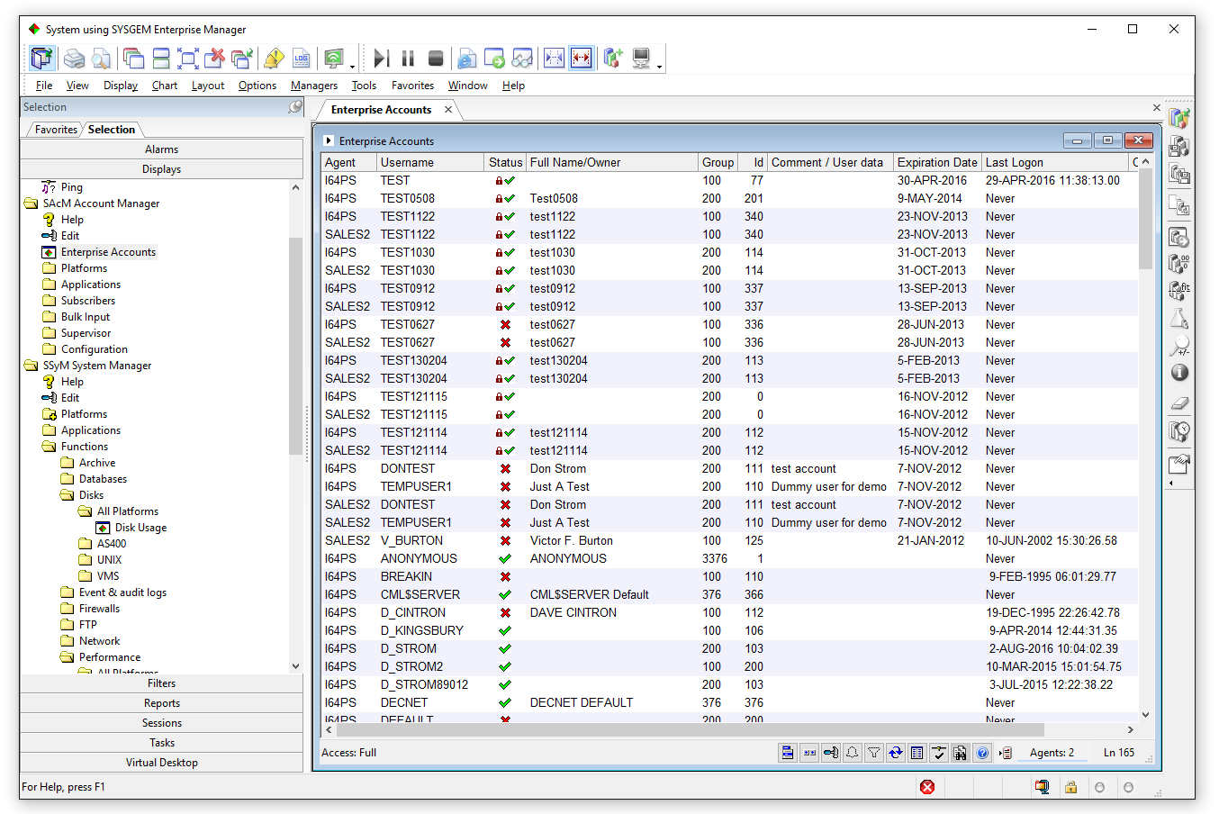
Demo4 – User Admin
Notes:
Enterprise Accounts window used by Help Desk / Use Admin / Security Gps.
Single SEM window lists accounts from multiple servers & platform types.
List can be sorted /filtered on any column, e.g.:
show accounts containing certain text string (across all servers)
users who belong to a certain UIC group
accounts with raised privileges
not logged in for a period of time
In this example – all users from 3 servers (782 users).
Click on “UIC” column title – who belongs to which groups over 3 servers.
Filter on UIC Group 100.
Filter hides information, doesn’t remove it. Remove filter - info returned.
Pre-set filters – e.g. raised privs. (3 servers - 156 raised priv’d accounts).
Sort on last login – why do accounts need raised privs if not used?
Most priv’d accounts are disabled (see status column).
Multiple selection of accounts – perform single menu option (e.g. disable).
Similarly – create accounts on multiple servers in a single transaction.

Slide 26
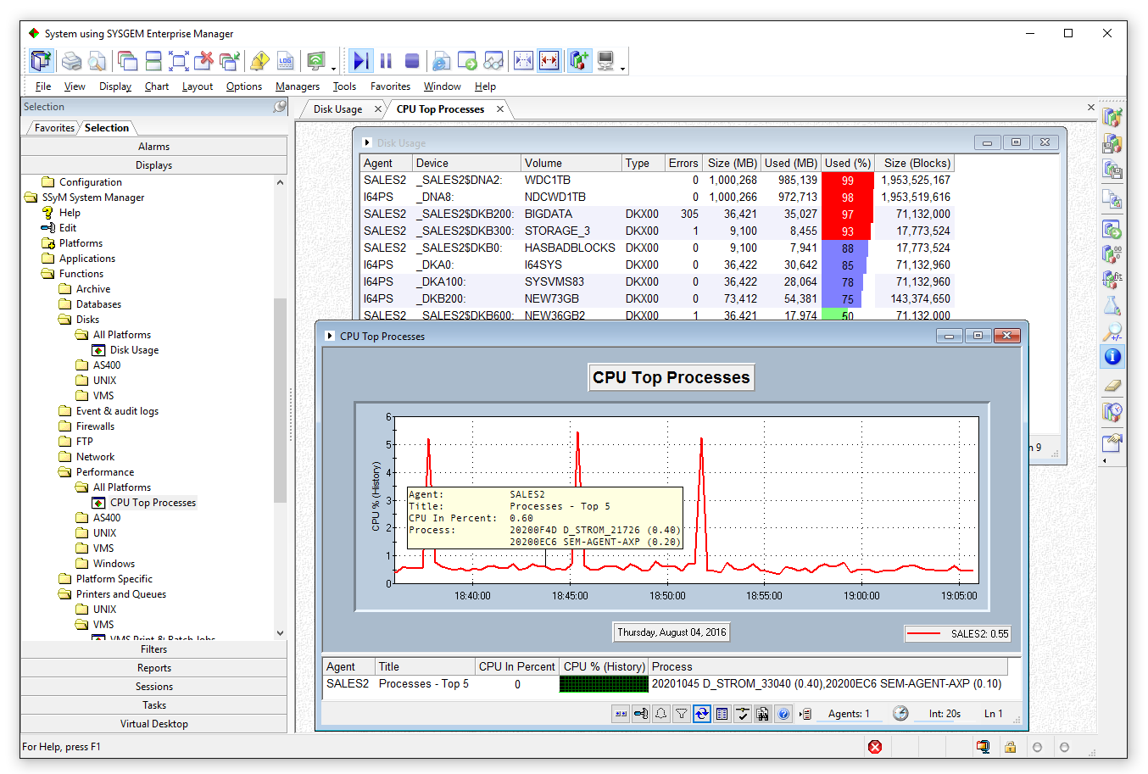
Demo5 – Monitor & Alarm
Notes:
Large number of SEM displays for monitoring servers & return info.
E.G. Disk Monitor:
which volumes available
device name
error counts
total size of the disks
amount of used space & free space in megabytes / blocks
Filters show or hide information that match criteria.
Automatic refresh.
Alarms – take action when thresholds exceeded:
email notification – different recipients based on calendar
run script on client
run script on server – with info regarding why alarm was triggered
Display not only text – but also chart representation when data = %ages.
CPU Usage as chart – drill down– see detailed info at any point.
Charts can be saved in a historical log and browsed after the event and run displays automatically 24/7 as Windows service.

Slide 27
Demo 6 - Dashboard

Slide 28
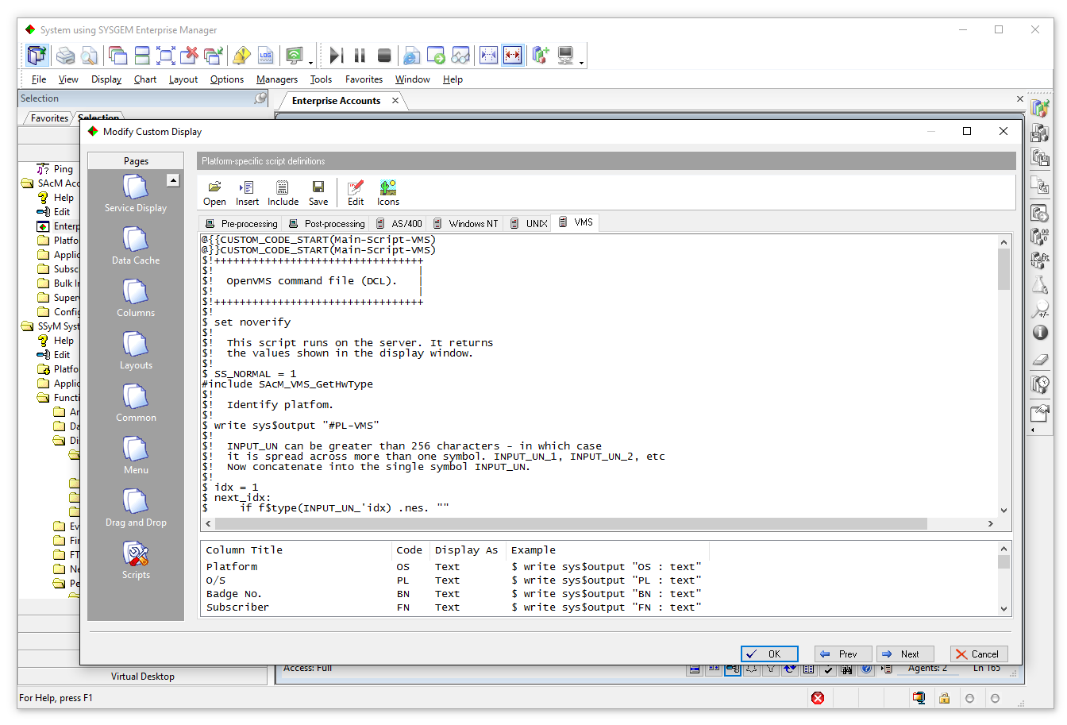
Customization of SEM
Notes:
Scripts run on the agent to gather information for display in the SEM window.
One script for each platform type – the appropriate on is sent to the connected agent(s) depending on the platform.
Pre- and Post- processing scripts run on the GUI before and after the main script is run on the agent to modify / filter the output from the agent.
Customisations included in a separate file and substituted at run–time. Custom Include files are NOT overwritten with software upgrades.
Custom Substitution code inserted at strategic points in the code.
Menu options – All code and UI available for customisations – and all can survive a software upgrade.
Conclusion – SEM has a very open architecture and can be customized to meet user needs.

Slide 29
Presenters
Shoshana Huss (Sysgem Marketing)
shoshana.huss@sysgem.com
Mike Schofield (Technical Support)
mike.schofield@sysgem.com
Contact in the US:
sales@networkingdynamics.com
www.sysgem.com

Slide 30
Sysgem Dashboard
Purpose
Centralize the management of automated monitoring in a single GUI
Check on running status of monitoring tasks
Check on overall health of target systems
Start new / stop existing monitoring tasks
See details of monitored data
Take action when target servers need a problem resolution

Slide 31
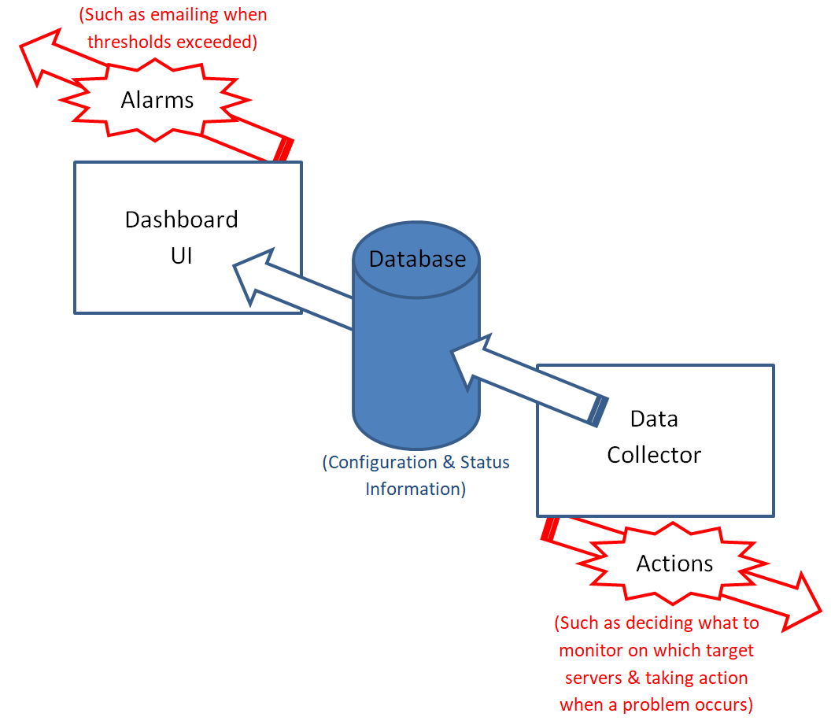
Dashboard Overview

Slide 32
Benefits - Customer Examples
Industry: US Steel Manufacturing
Goal: Avoid costly downtime – need to keep plant running 24/7
Examples of alarms configured by the customer using SEM:
High CPU usage: SEM identifies the run-away program in the alarm message so that a remedy can be quickly implemented. “This has been extremely valuable in debugging our applications and preventing downtime.”
Disk drive failure: Disks are configured as RAID 1. “The alarms notify us of problems and allow our RAID 1 disks to be recovered quickly before more serious problems occur.”
RAID controller cache battery: Prevents possible data loss or corruption. “This alarm lets us know when the battery is not charging and needs to be replaced.”
Consequence: Avoids catastrophic downtime of our plant which would cost us $20,000 per hour or more

Slide 33
Benefits - Customer Examples
Industry: International Aerospace Manufacturing
Goal: To provide a Network Operations Center (NOC)
“Our organization didn’t have an NOC, so we’ve leveraged SEM as a ‘Virtual NOC’.”
Here are a few examples:
Network
SEM ensures client availability by pinging and reporting exceptions
System Security
SEM monitors system intrusions and reports excessive password failures
Operations
Customized rules ensure required batch jobs / detached processes are always present / running. They are restarted if they have failed.
SEM reports on: stopped print queues; potential runaway processes; high CPU load
Hardware
SEM monitors: shadowed disks (reporting on status change); disk space (with alarms set for different thresholds on different disks)
“We found that previous ‘watchdog jobs’ only added more processes to our systems, whereas SEM has only one agent process on a server.”
“Having a centralized reporting facility in SEM means we don’t have to spend time digging through log files. We just glance at the display for a real-time status.”

Slide 34
Benefits - Customer Examples
Industry: Electronic Engineering (S&P 500)
Goal: Need to keep VMS Systems running 24/7 across US and Asia
Example uses of SEM:
File Synchronization between systems
File & Directory Explorer of VMS systems
Performance Management
Queues Explorer
Highly configurable alarms
Consequence: Minimizes requirements on support staff
“Without SEM we would have had to purchase multiple (and expensive) tools or develop in-house DCL procedures.”

