Slide 1
Centene Access Admin / Sysgem
To understand how Centene use SEM Sept-15, 2020

Slide 2
Understanding how Centene use SEM
There are 400 SEM user accounts – they enable access by Centene staff to OpenVMS user account management
Over 100 Centene users log into SEM regularly
Why so many people managing VMS accounts?
Do they all use SEM in the same way?

Slide 3
Understanding how Centene use SEM
OpenVMS accounts are usually three characters long
An account is automatically deleted if it isn’t used in a 3-month period
If a VMS account is created for a user who has had their previous account automatically deleted, is there an attempt to use the same username? If “Yes, but only for some” – what %age?
How are names that were previously used by a user detected?

Slide 4
Understanding how SEM is used during peak periods
Very many VMS accounts are created in the fall each year
Some accounts are created using “Bulk-Input” in SEM
How many total accounts created in the peak period?
How many of those are created using Bulk-Input?
What %age of accounts are not linked to previously used usernames?
How many VMS accounts remain in regular use throughout the year?

Slide 5
Understanding how Centene use SEM
There is an “Access” database used by Access Admin
There is an “ABS report” that references users and their accounts
How are these sources of information used, & by whom?
How easy is it to use these sources of information?
Are they reliable / kept up-to-date / are there other sources?
How does a SEM user pick an available, new, 3-char username?
How does Centene apportion new usernames between SEM users?

Slide 6
Depending on the answers to the above questions…
It is possible to customize SEM to help Access Admin…
Would it be beneficial for SEM to:
Automatically (& optionally) select a new username during account creation
Automatically update a database with allocated usernames
Regularly scan accounts on the VMS clusters & compare with database entries
Automatically update available list of accounts in DB when VMS accounts deleted
Maintain a history of VMS accounts in DB per cluster (e.g. dates created / deleted / HN & CN references / other fields from VMS accounts such as Rights IDs)
Allow browsing / export from database of batches of usernames for Bulk Input / etc.
Sync the content of the database with other sources of information

Slide 7
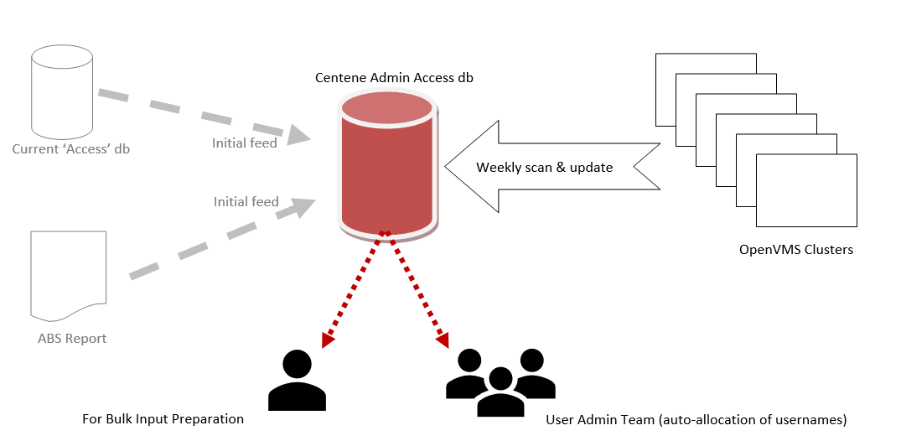
Possible Solution:

Slide 8
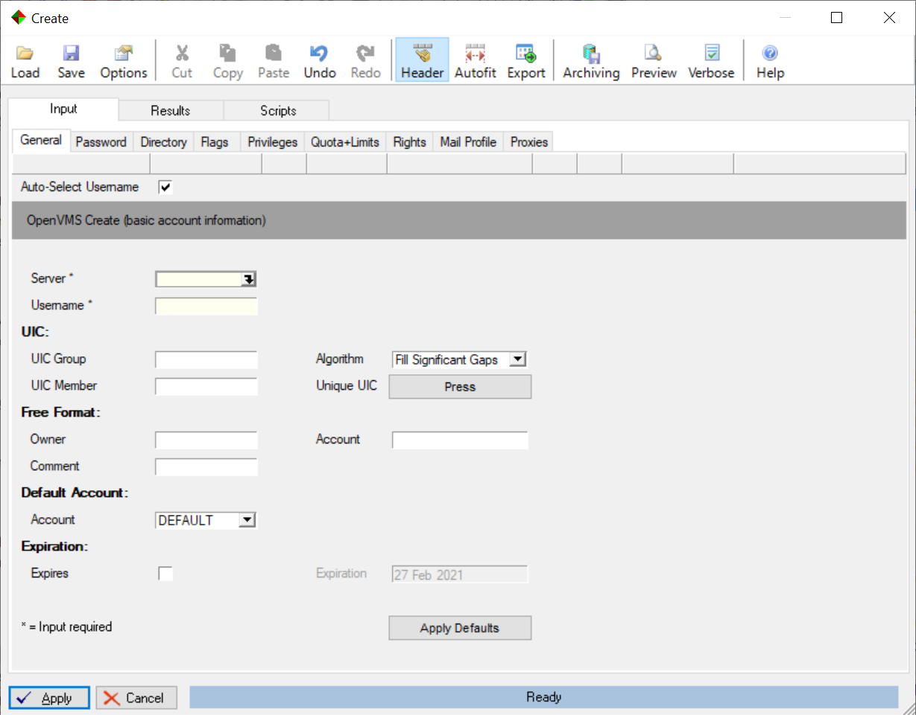
Possible Solution:

Slide 9
Possible Solution (Access Admin DB):
3-char Username
Cluster name
HN Ref
UIC group
CN Ref
UIC member
Status
Comment field
sub-record
(in Access Admin DB)
Modified date
Privs
Rights ID
Account Record (in Access Admin DB)
Def Dev
Status
Last login
Date created
Date deleted
VMS Account
On a Cluster (when applicable)

